Slide 1
MODERN OPERATING SYSTEMS
Third Edition
ANDREW S. TANENBAUM
Chapter 3
Memory Management
Tanenbaum, Modern Operating Systems 3 e, (c) 2008 Prentice-Hall, Inc. All rights reserved. 0-13-6006639

Slide 2

No Memory Abstraction
Figure 3-1. Three simple ways of organizing memory with an operating system and one user process.
Tanenbaum, Modern Operating Systems 3 e, (c) 2008 Prentice-Hall, Inc. All rights reserved. 0-13-6006639

Slide 3
Relocation and Protection
Cannot be sure where program will be loaded in memory
  address locations of variables, code routines cannot be absolute
  must keep a program out of other processes’ partitions
Use base and limit values
  address locations added to base value to map to physical addr
  address locations larger than limit value is an error

Slide 4
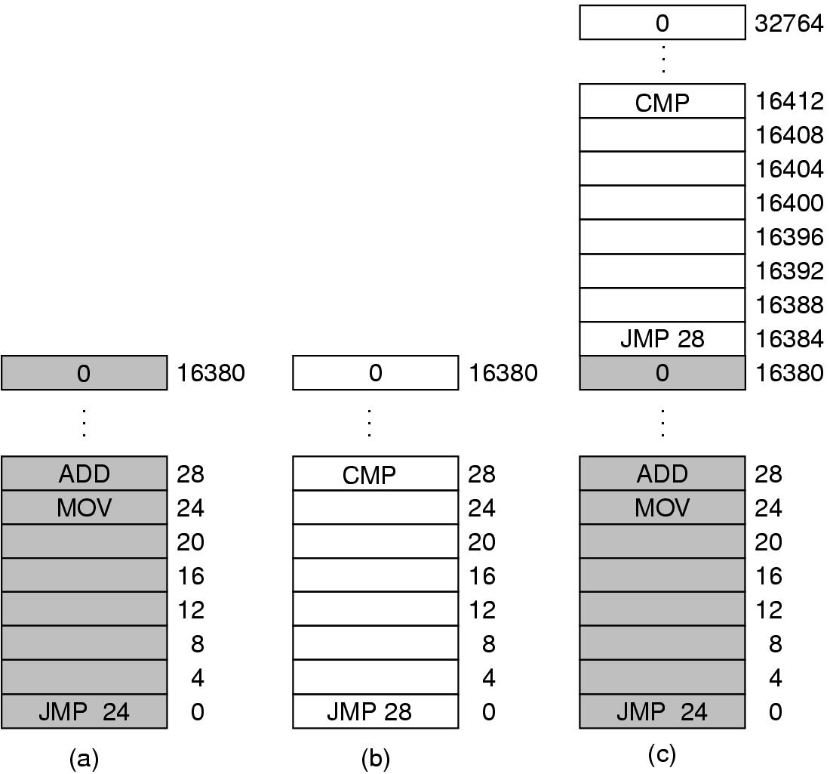
Multiple Programs Without Memory Abstraction
Figure 3-2. Illustration of the relocation problem.
Tanenbaum, Modern Operating Systems 3 e, (c) 2008 Prentice-Hall, Inc. All rights reserved. 0-13-6006639

Slide 5
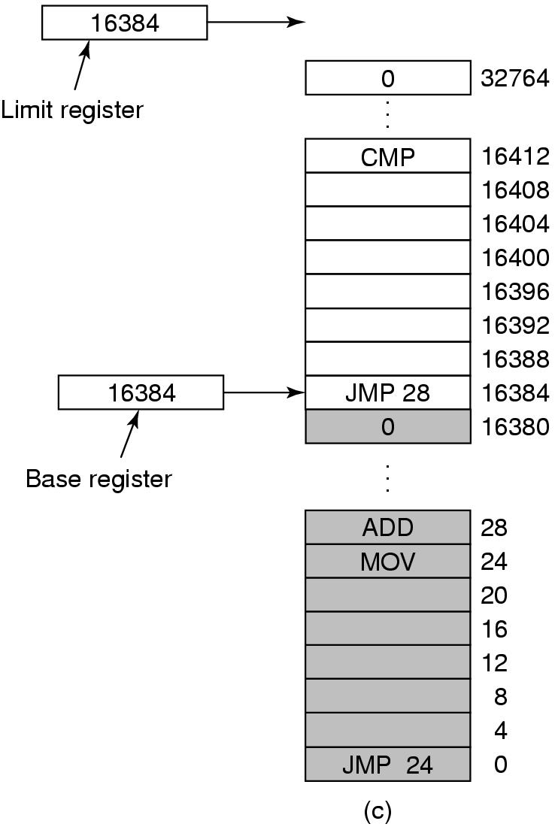
Base and Limit Registers
Figure 3-3. Base and limit registers can be used to give each process a separate address space.
Tanenbaum, Modern Operating Systems 3 e, (c) 2008 Prentice-Hall, Inc. All rights reserved. 0-13-6006639

Slide 6

Swapping (1)
Figure 3-4. Memory allocation changes as processes come into memory and leave it. The shaded regions are unused memory.
Tanenbaum, Modern Operating Systems 3 e, (c) 2008 Prentice-Hall, Inc. All rights reserved. 0-13-6006639

Slide 7

Swapping (2)
Figure 3-5. (a) Allocating space for growing data segment. (b) Allocating space for growing stack, growing data segment.
Tanenbaum, Modern Operating Systems 3 e, (c) 2008 Prentice-Hall, Inc. All rights reserved. 0-13-6006639

Slide 8

Memory Management with Bitmaps
a) Part of memory with 5 processes, 3 holes
  tick marks show allocation units
  shaded regions are free
b) Corresponding bit map
c) Same information as a list
Tanenbaum, Modern Operating Systems 3 e, (c) 2008 Prentice-Hall, Inc. All rights reserved. 0-13-6006639

Slide 9
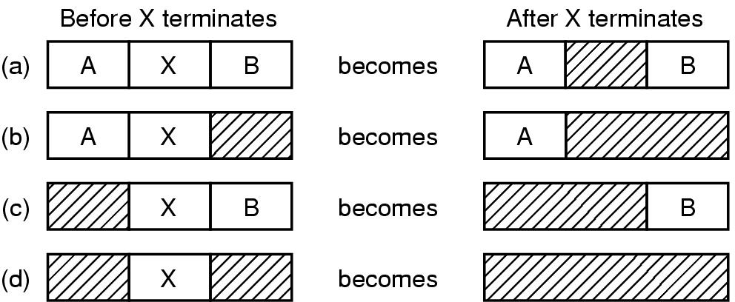
Memory Management with Linked Lists
Figure 3-7. Four neighbor combinations
for the terminating process, X.
Tanenbaum, Modern Operating Systems 3 e, (c) 2008 Prentice-Hall, Inc. All rights reserved. 0-13-6006639

Slide 10

Swapping Algorithms
First Fit – Use 1st hole that is large enough
Next Fit – Use “next” hole that is large enough
Best Fit – Use the smallest hole that is large enough
Worst Fit – Use the largest hole
Quick Fit – Use hole from list with holes of size 2*k

Slide 11

Virtual Memory
Years ago, programmers were confronted with a difficult challenge:
How does one squeeze a huge program into a little bit of RAM?
Virtual Pages
Page Frames
Software on disk
RAM

Slide 12

Virtual Memory – Paging (1)
Figure 3-8. The position and function of the MMU – shown as being a part of the CPU chip (it commonly is nowadays). Logically it could be a separate chip, was in years gone by.
Tanenbaum, Modern Operating Systems 3 e, (c) 2008 Prentice-Hall, Inc. All rights reserved. 0-13-6006639

Slide 13
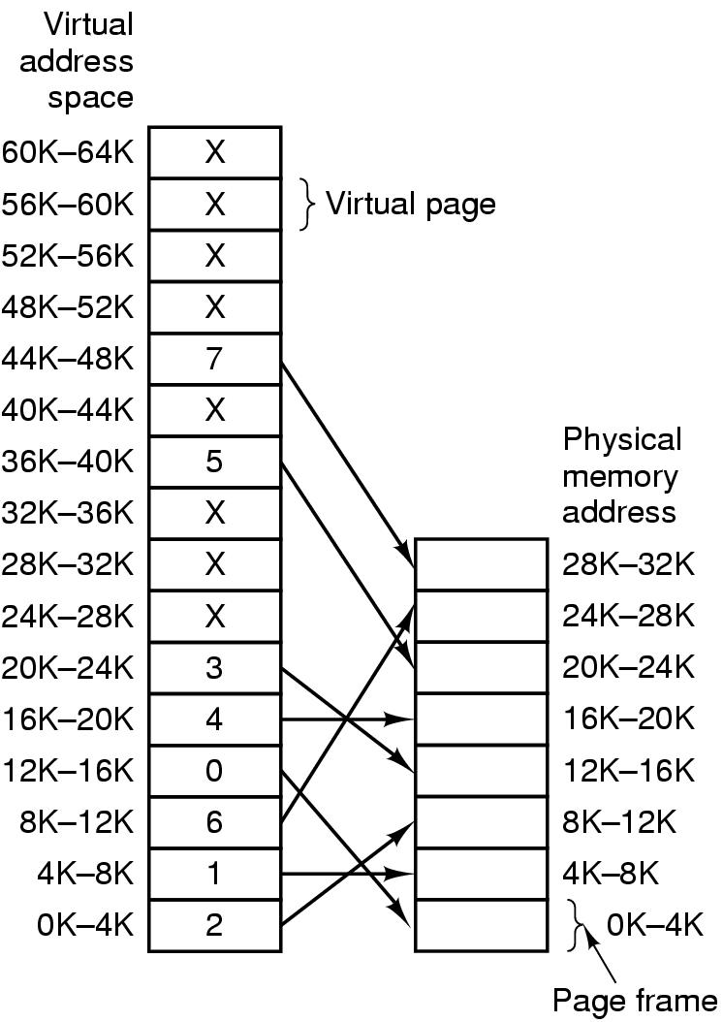
Paging (2)
Figure 3-9. Relation between virtual addresses and physical memory addresses given by page table.
Tanenbaum, Modern Operating Systems 3 e, (c) 2008 Prentice-Hall, Inc. All rights reserved. 0-13-6006639

Slide 14

Paging (3)
Figure 3-10. The internal operation of the MMU with 16 4-KB pages.
Tanenbaum, Modern Operating Systems 3 e, (c) 2008 Prentice-Hall, Inc. All rights reserved. 0-13-6006639

Slide 15

Structure of Page Table Entry
Figure 3-11. A typical page table entry.
Tanenbaum, Modern Operating Systems 3 e, (c) 2008 Prentice-Hall, Inc. All rights reserved. 0-13-6006639

Slide 16
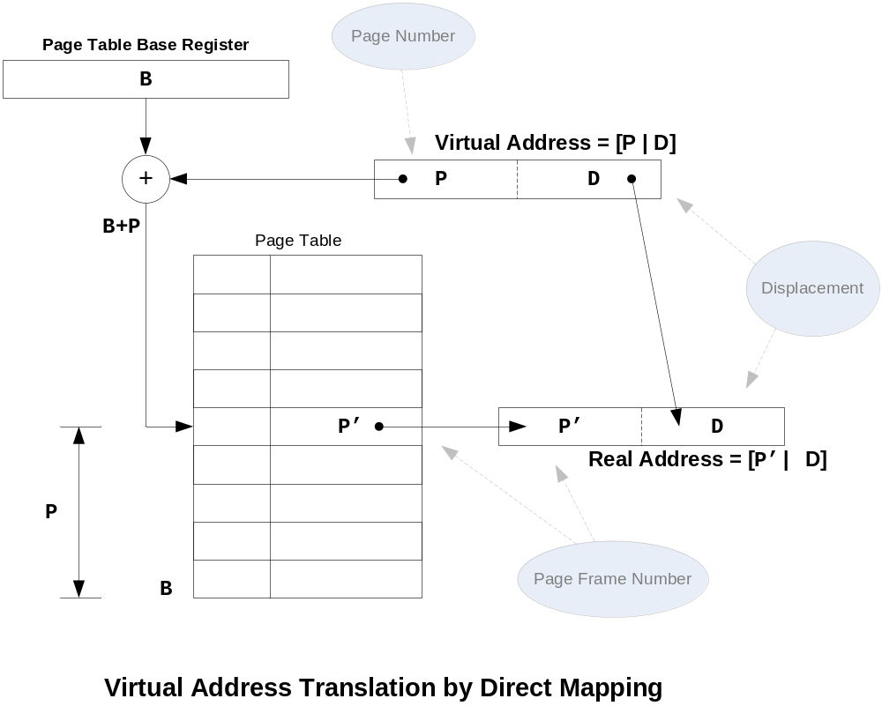

Slide 17
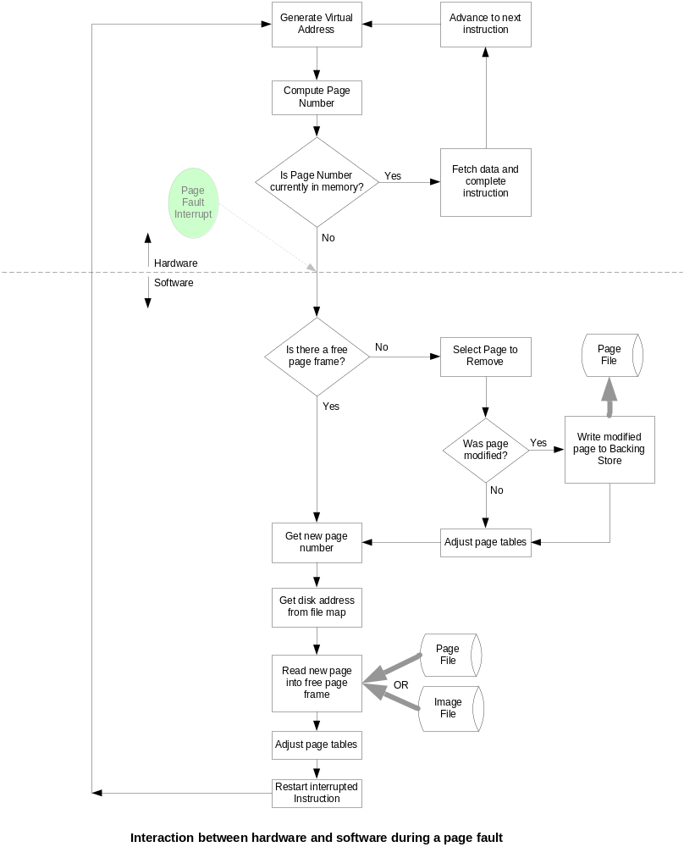
Page Faults and the ‘Backing Store’
Standard Instruction Cycle
Memory Manager (O.S.)

Slide 18
Speeding Up Paging
Paging implementation issues:
The mapping from virtual address to physical address must be fast (VERY FAST).
  TLB
If the virtual address space is large, the page table will be large (with 64-bit address – VERY LARGE).
  Multi-Level Paging
  Inverted Page Tables
Tanenbaum, Modern Operating Systems 3 e, (c) 2008 Prentice-Hall, Inc. All rights reserved. 0-13-6006639

Slide 19
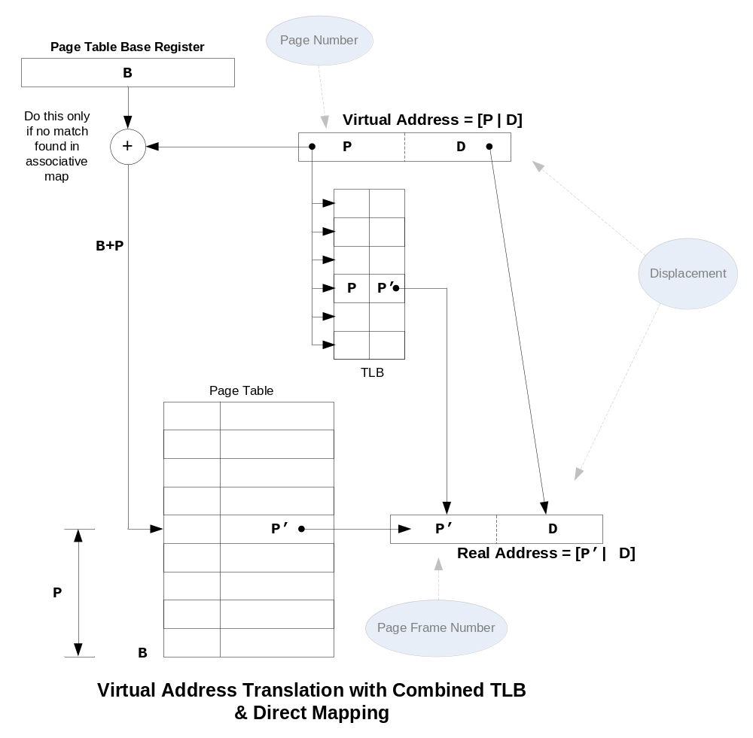

Slide 20
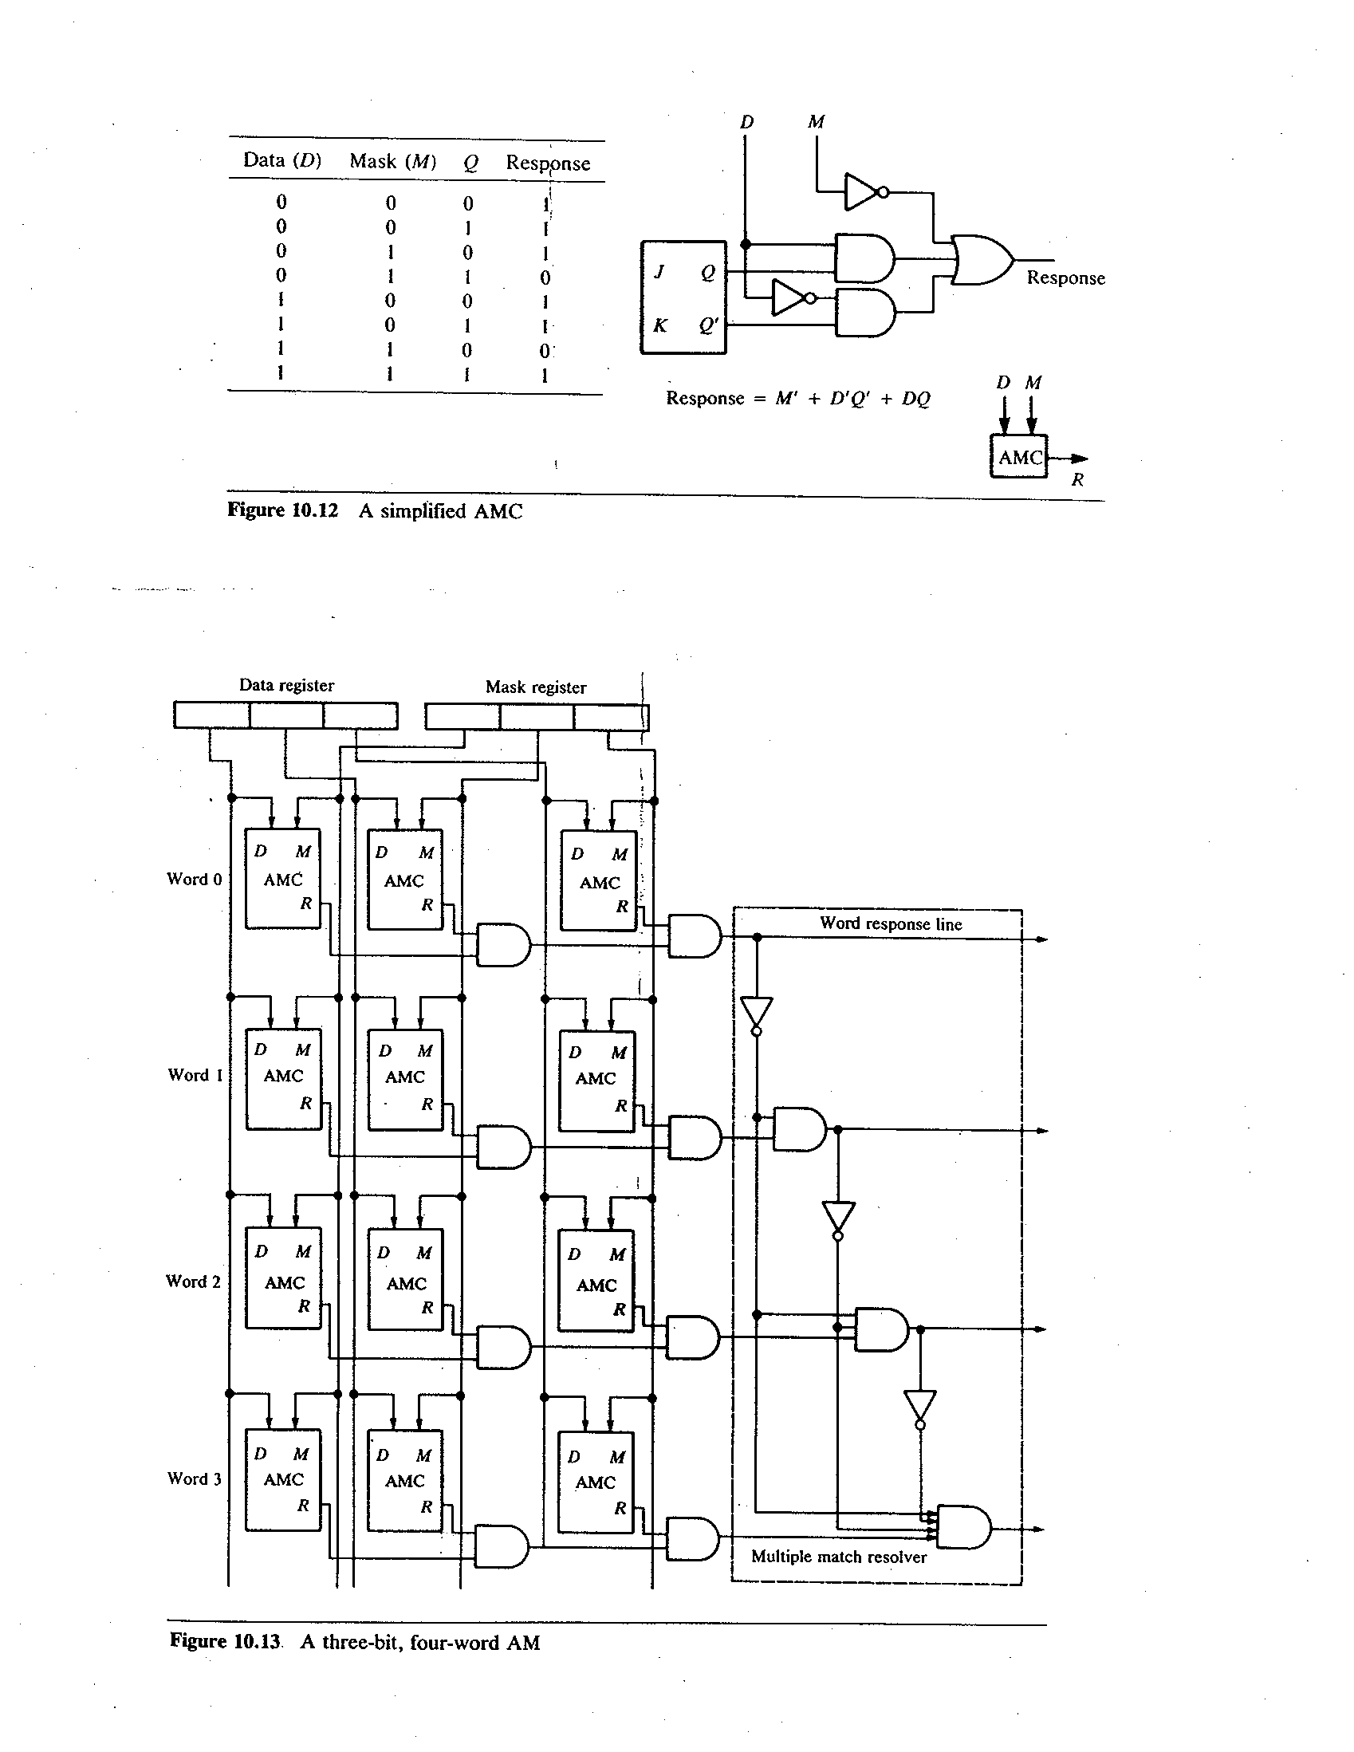

Slide 21
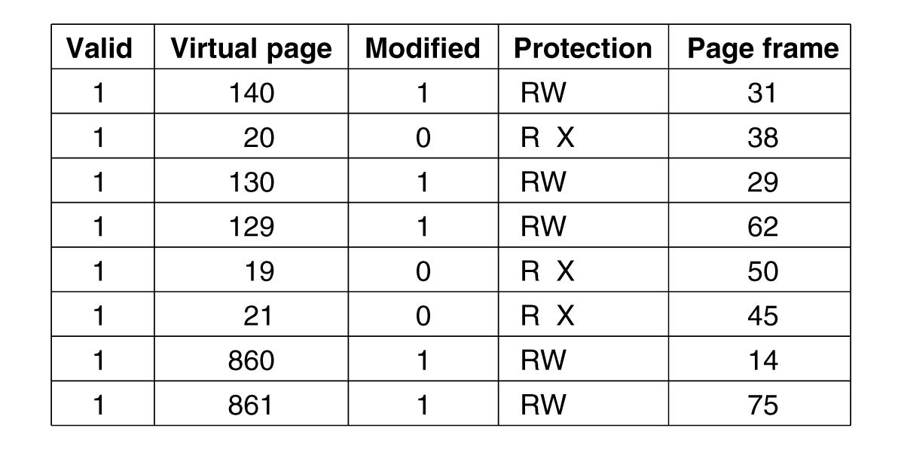
Translation Lookaside Buffers
Figure 3-12. A TLB to speed up paging.
Tanenbaum, Modern Operating Systems 3 e, (c) 2008 Prentice-Hall, Inc. All rights reserved. 0-13-6006639

Slide 22

Multilevel Page Tables
Figure 3-13. (a) A 32-bit address with two page table fields.
(b) Two-level page tables.
Tanenbaum, Modern Operating Systems 3 e, (c) 2008 Prentice-Hall, Inc. All rights reserved. 0-13-6006639

Slide 23
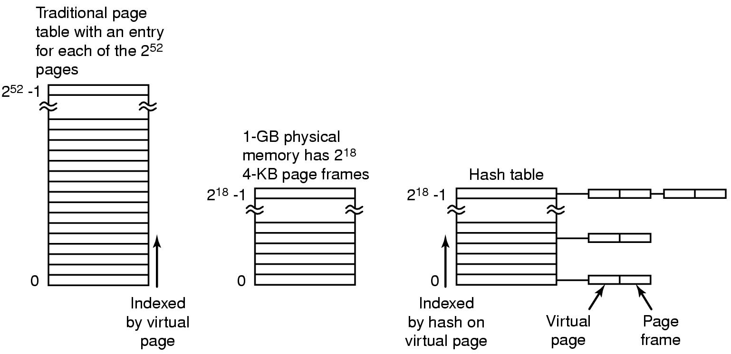
Inverted Page Tables
Figure 3-14. Comparison of a traditional page table
with an inverted page table.
Tanenbaum, Modern Operating Systems 3 e, (c) 2008 Prentice-Hall, Inc. All rights reserved. 0-13-6006639

Slide 24
Page Replacement Algorithms
Page fault forces choice
  In which page frame should incoming page be mapped?
  If all frames are occupied, which page should be removed
Modified page (eg. dirty page) must first be saved on disk
  If unmodified , the page frame can simply be overwritten
Preferably not choose an often-used page
  Will probably need such a page to be brought back in soon

Slide 25
Page Replacement Algorithms
Optimal page replacement algorithm
Not recently used page replacement
First-In, First-Out page replacement
Second chance page replacement
Clock page replacement
Least recently used page replacement
Working set page replacement
WSClock page replacement
Tanenbaum, Modern Operating Systems 3 e, (c) 2008 Prentice-Hall, Inc. All rights reserved. 0-13-6006639

Slide 26
Optimal Page Replacement Algorithm
Replace page needed at the farthest point in future
  Optimal but unrealizable
Estimate by …
  logging page use on previous runs of process
  although this too is impractical

Slide 27
Not Recently Used (NRU)
Page Replacement Algorithm
Each page has Reference bit, R, & Modified bit, M.
  R & M bits are initially set to 0.
  bits are set to 1 when page is referenced or modified
  reference bit is periodically cleared (e.g., quantum interrupt)
Pages are classified
  not referenced recently, not modified (R=0,M=0)
  not referenced recently, modified (R=0, M=1)
  referenced recently, not modified (R=1, M=0)
  referenced recently, modified (R=1, M=1)
NRU removes page at random from lowest numbered, non-empty class

Slide 28
FIFO Page Replacement Algorithm
Maintain a linked list of all pages
  in order they came into memory (place new pages at end of queue)
Replace page at beginning of list (oldest page)
Disadvantage
  page in memory the longest may be used often

Slide 29
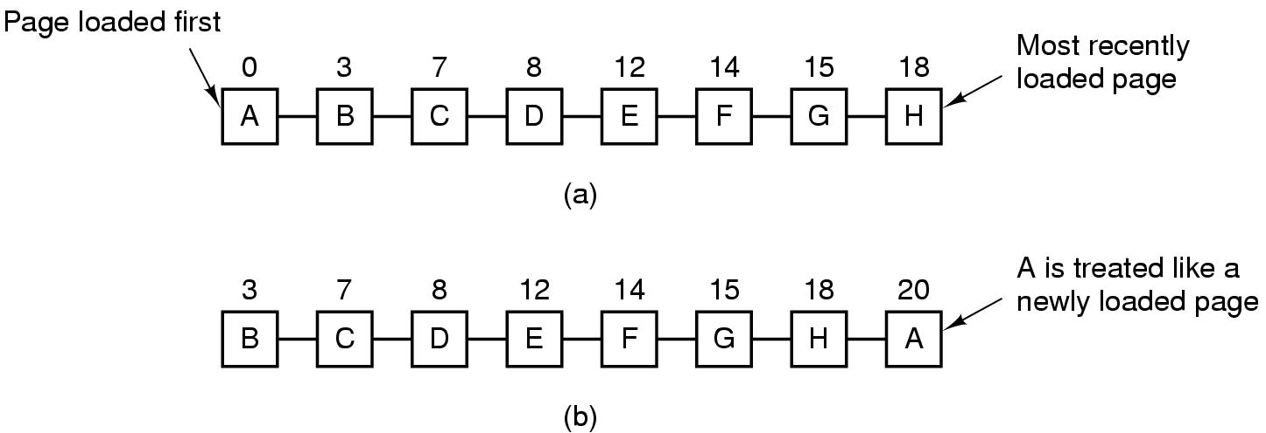
Second Chance Algorithm
Figure 3-15. Operation of second chance.
(a) Pages sorted in FIFO order.
(b) Page list if a page fault occurs at time 20 and A has its R bit set. The numbers above the pages are their load times.
Tanenbaum, Modern Operating Systems 3 e, (c) 2008 Prentice-Hall, Inc. All rights reserved. 0-13-6006639

Slide 30
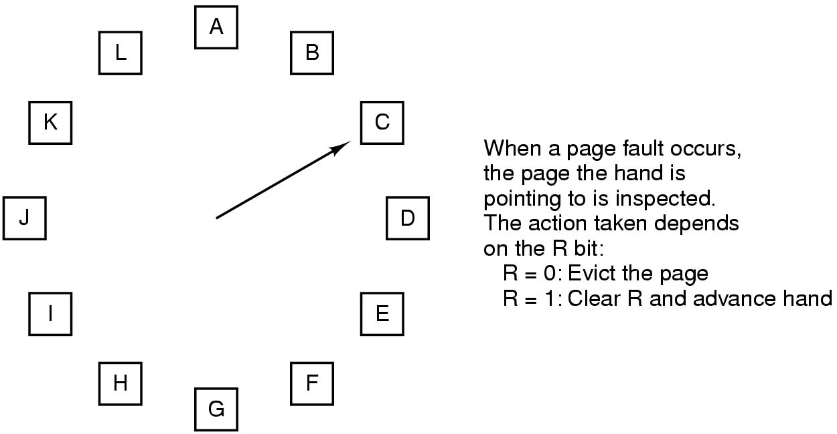
The Clock Page Replacement Algorithm
Figure 3-16. The clock page replacement algorithm.
Tanenbaum, Modern Operating Systems 3 e, (c) 2008 Prentice-Hall, Inc. All rights reserved. 0-13-6006639

Slide 31
Least Recently Used (LRU)
Assume pages used recently will be used again soon
  throw out page that has been unused for longest time
Must keep a linked list of pages
  most recently used at front, least at rear
  update this list every memory reference !!
Alternatively, keep counter in each page table entry
  choose page with lowest value counter
  periodically zero the counter

Slide 32
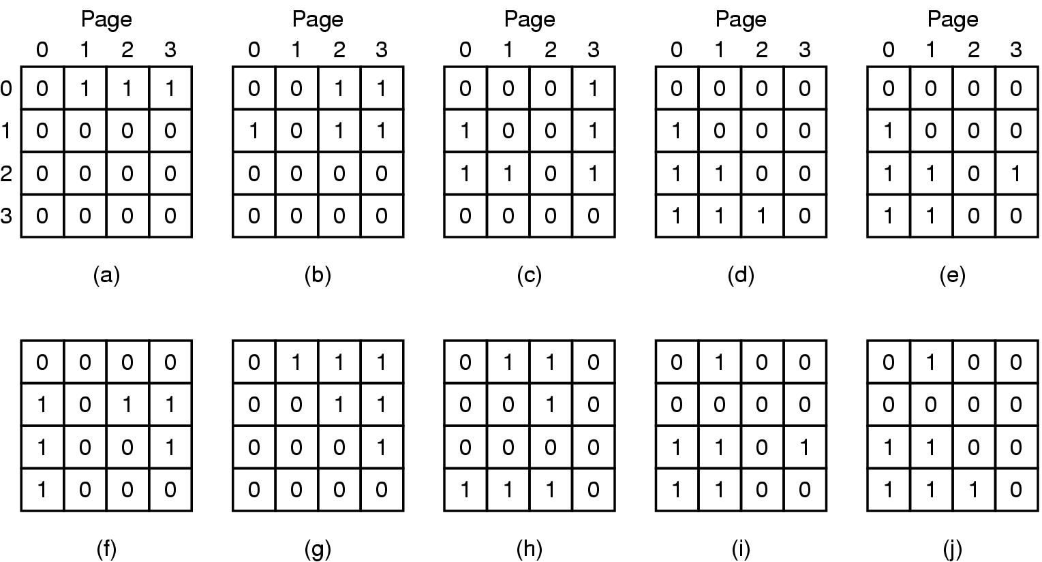
LRU Page Replacement Algorithm
Figure 3-17. LRU using a matrix when pages are referenced in the order 0, 1, 2, 3, 2, 1, 0, 3, 2, 3.
Tanenbaum, Modern Operating Systems 3 e, (c) 2008 Prentice-Hall, Inc. All rights reserved. 0-13-6006639

Slide 33
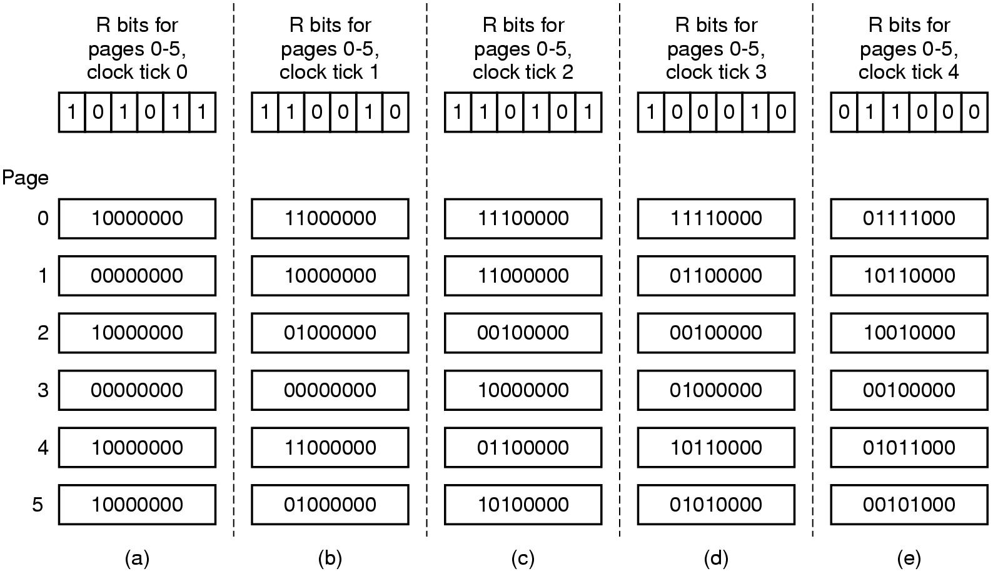
Simulating LRU in Software (using Aging)
Figure 3-18. The aging algorithm simulates LRU in software. Shown are six pages for five clock ticks. The five clock ticks are represented by (a) to (e).
Tanenbaum, Modern Operating Systems 3 e, (c) 2008 Prentice-Hall, Inc. All rights reserved. 0-13-6006639

Slide 34
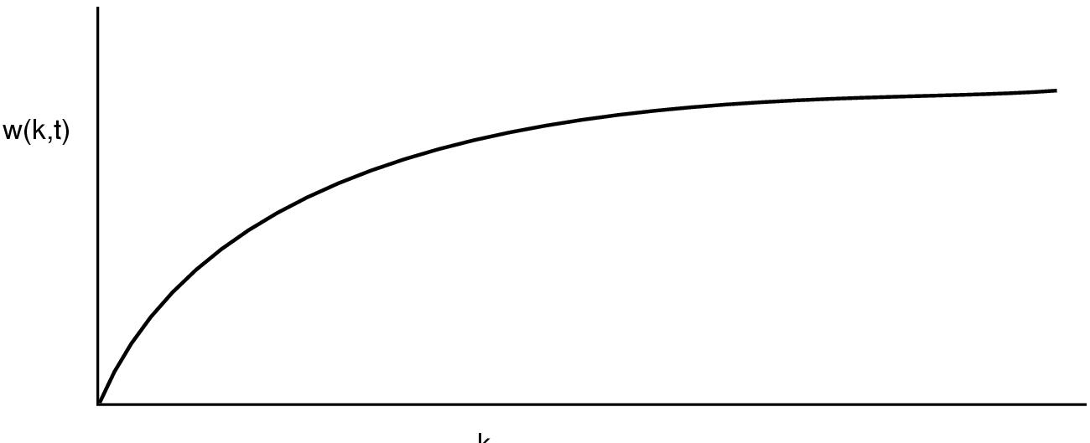
Working Set Page Replacement (1)
Figure 3-19. The working set is the set of pages used by the k most recent memory references. The function w(k, t) is the size of the working set at time t.
Tanenbaum, Modern Operating Systems 3 e, (c) 2008 Prentice-Hall, Inc. All rights reserved. 0-13-6006639

Slide 35
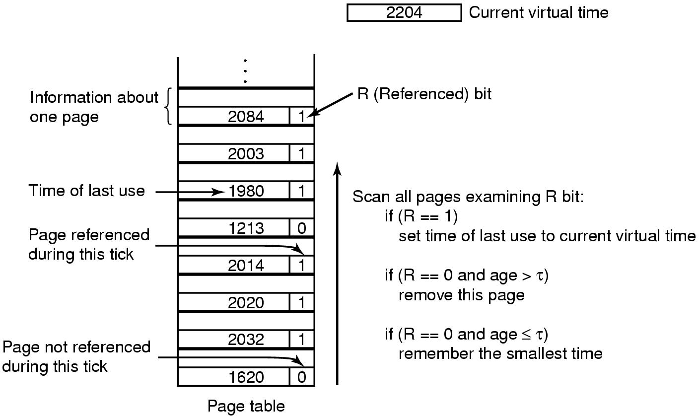
Working Set Page Replacement (2)
Figure 3-20. The working set algorithm.
Tanenbaum, Modern Operating Systems 3 e, (c) 2008 Prentice-Hall, Inc. All rights reserved. 0-13-6006639

Slide 36
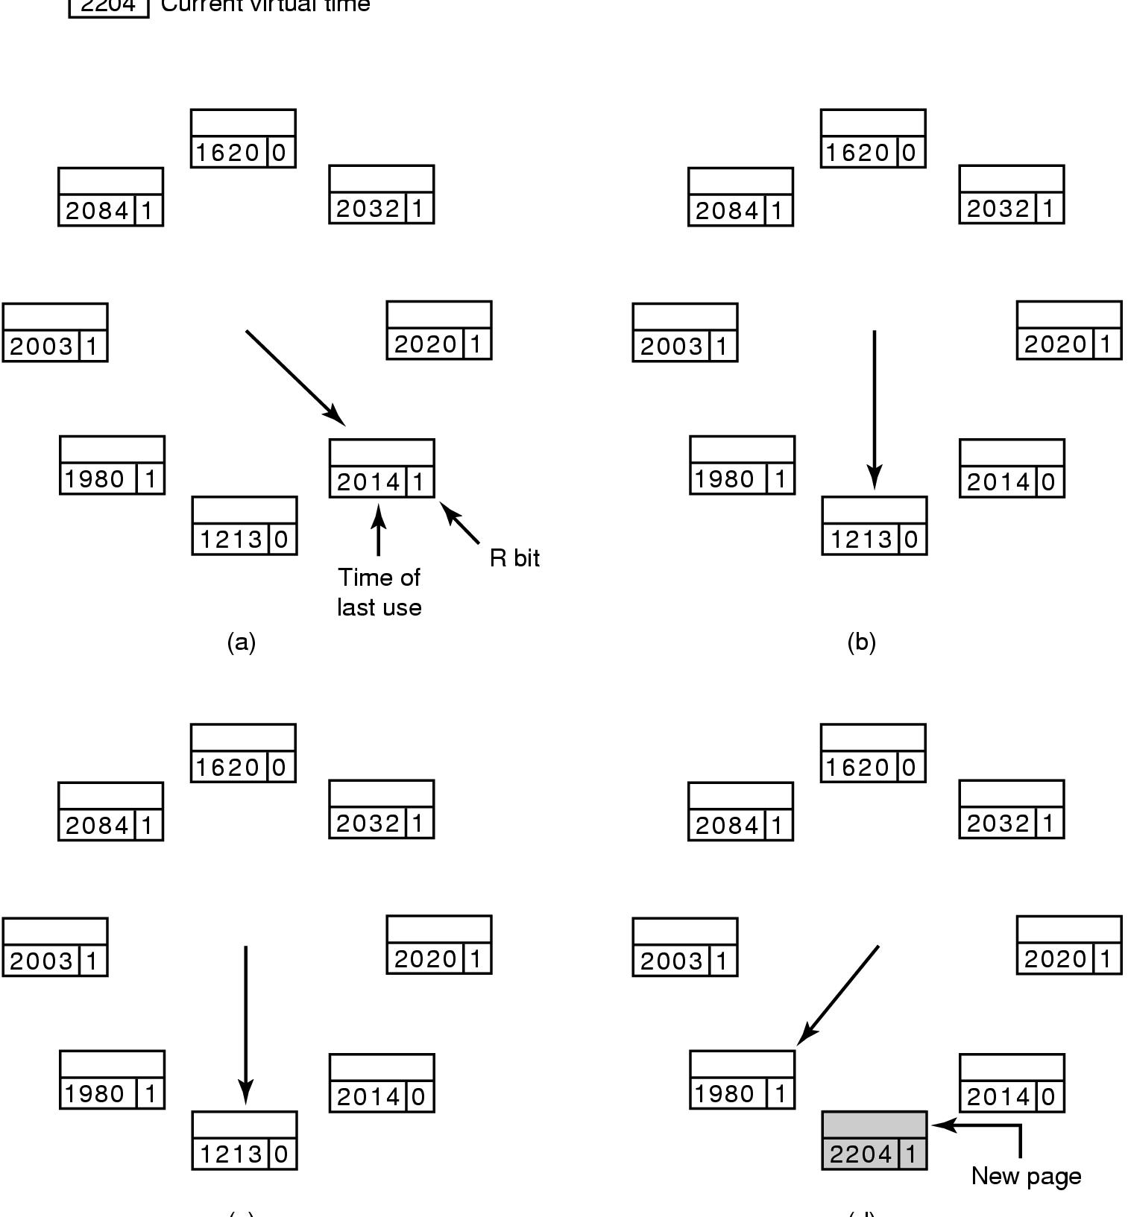
The WSClock Page Replacement Algorithm (2)
Age = (CurrentVirtualTime - TimeOfLastUse)
If (R == 1 or Age <= τ)
{
Set R to 0
Advance pointer to next page entry.
}
Else
{
if (Page is ‘clean’)
{
Select this page for replacement
}
else
{
Schedule a WriteToDisk request
Advance pointer to the next page entry
}
}
Figure 3-21. Operation of the WSClock algorithm. (a) and (b) give an example of what happens when R = 1.
Tanenbaum, Modern Operating Systems 3 e, (c) 2008 Prentice-Hall, Inc. All rights reserved. 0-13-6006639

Slide 37
The WSClock Page Replacement Algorithm (1)
When the hand comes all the way around to its
starting point there are two cases to consider:
At least one write has been scheduled – just keep looking, a clean page will eventually be found.
No writes have been scheduled - replace any clean page; if no clean page exists, replace current page.
Tanenbaum, Modern Operating Systems 3 e, (c) 2008 Prentice-Hall, Inc. All rights reserved. 0-13-6006639

Slide 38
The WSClock Page Replacement Algorithm (3)
Figure 3-21. Operation of the WSClock algorithm.
(c) and (d) give an example of R = 0.
Tanenbaum, Modern Operating Systems 3 e, (c) 2008 Prentice-Hall, Inc. All rights reserved. 0-13-6006639

Slide 39
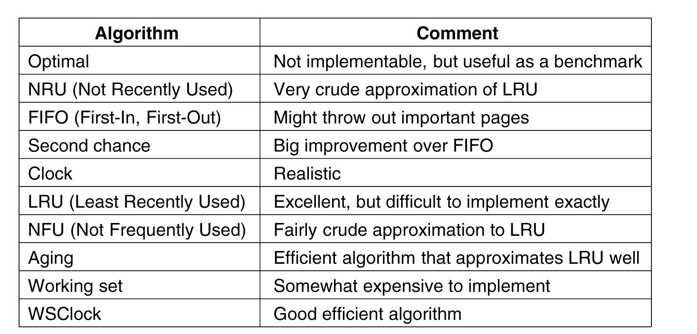
Summary of Page Replacement Algorithms
Figure 3-22. Page replacement algorithms discussed in the text.
Tanenbaum, Modern Operating Systems 3 e, (c) 2008 Prentice-Hall, Inc. All rights reserved. 0-13-6006639

Slide 40
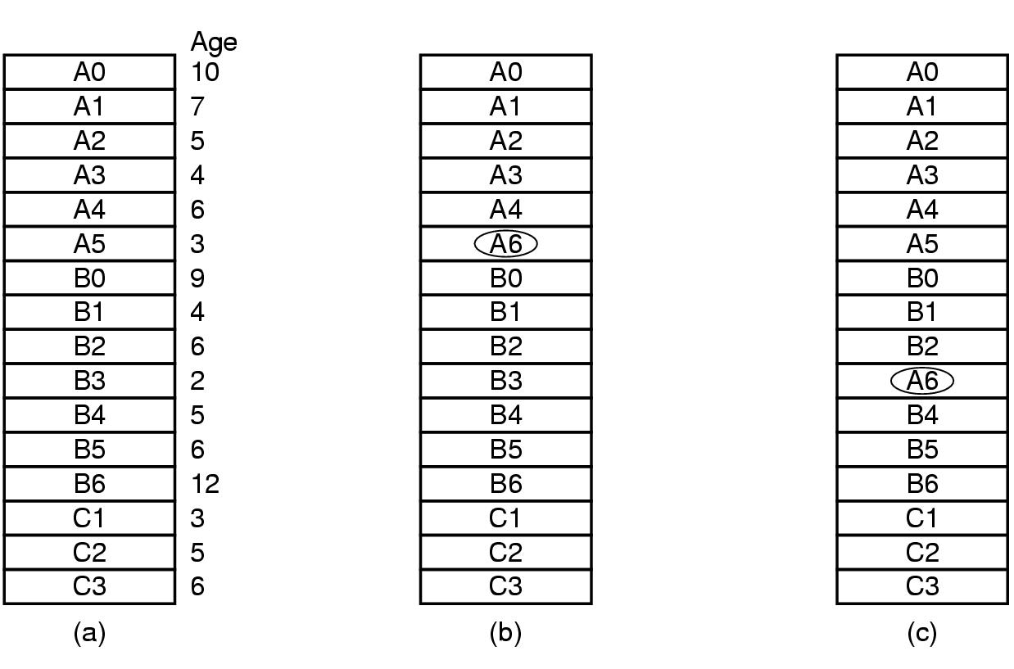
Local versus Global Allocation Policies (1)
Figure 3-23. Local versus global page replacement.
(a) Original configuration. (b) Local page replacement.
(c) Global page replacement.
Tanenbaum, Modern Operating Systems 3 e, (c) 2008 Prentice-Hall, Inc. All rights reserved. 0-13-6006639

Slide 41
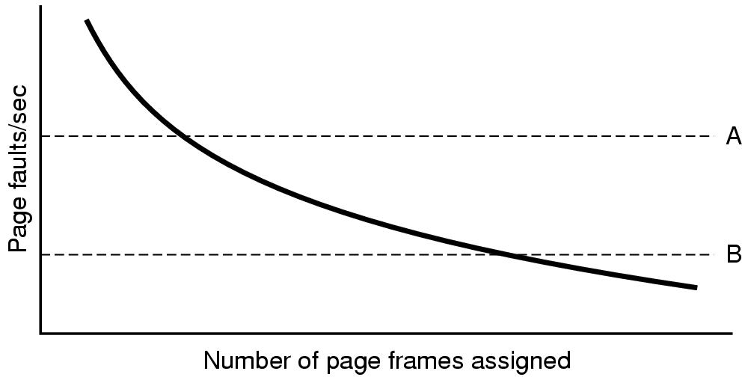
Local versus Global Allocation Policies (2)
Figure 3-24. Page fault rate as a function
of the number of page frames assigned.
Tanenbaum, Modern Operating Systems 3 e, (c) 2008 Prentice-Hall, Inc. All rights reserved. 0-13-6006639

Slide 42
Load Control
Despite good designs, system may still thrash
  Thrashing = causing page faults every few instructions
PFF (page fault frequency) may indicate:
  some processes need more memory – some less
  but what should happen when no processes need less
Solution :
Reduce number of processes competing for memory
  swap one or more to disk, divide up pages they held among other processes

Slide 43
Page Size (1)
Small page size
Advantages
  less internal fragmentation
  better fit for various data structures, code sections, etc
  less unused program in memory
Disadvantages
  programs need many pages, larger page tables

Slide 44
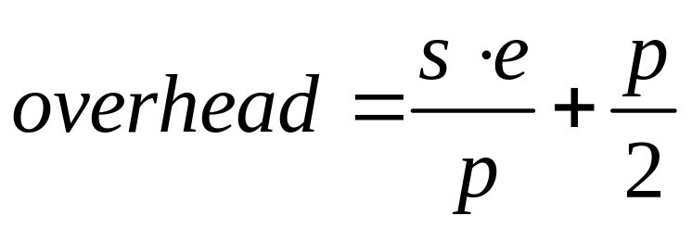
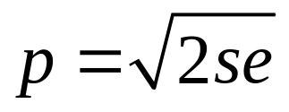
Page Size (2)
Overhead due to page table and internal fragmentation
Where
  s = average process size in bytes
  p = page size in bytes
  e = page entry
page table space
internal fragmentation
Optimized when

Slide 45
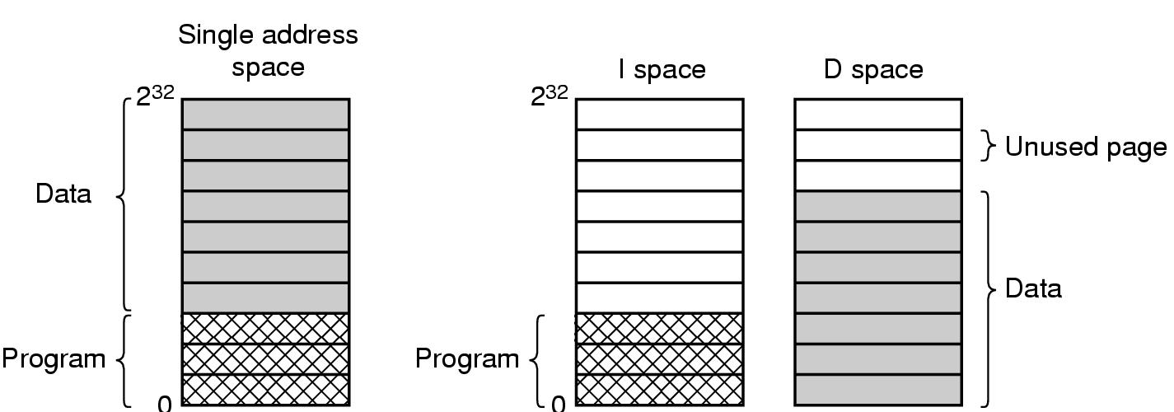
Separate Instruction and Data Spaces
Figure 3-25. (a) One address space.
(b) Separate I and D spaces.
Tanenbaum, Modern Operating Systems 3 e, (c) 2008 Prentice-Hall, Inc. All rights reserved. 0-13-6006639

Slide 46
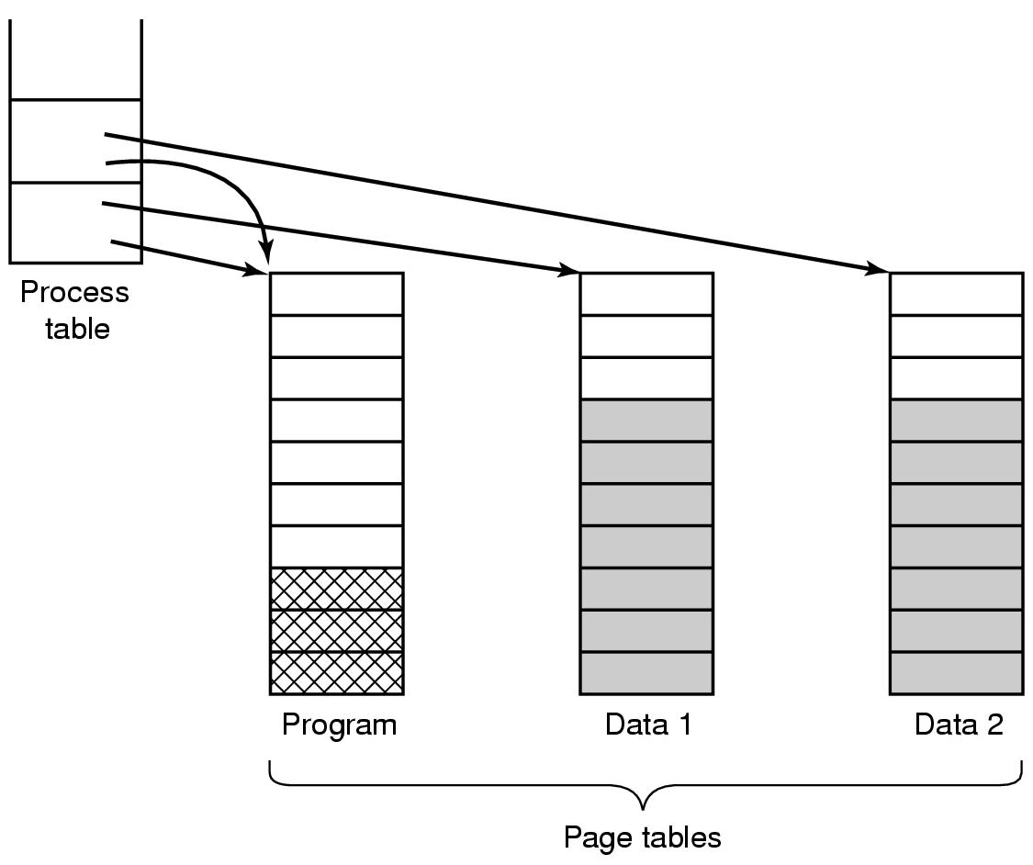
Shared Pages
Figure 3-26. Two processes sharing the same program
sharing its page table.
Tanenbaum, Modern Operating Systems 3 e, (c) 2008 Prentice-Hall, Inc. All rights reserved. 0-13-6006639

Slide 47
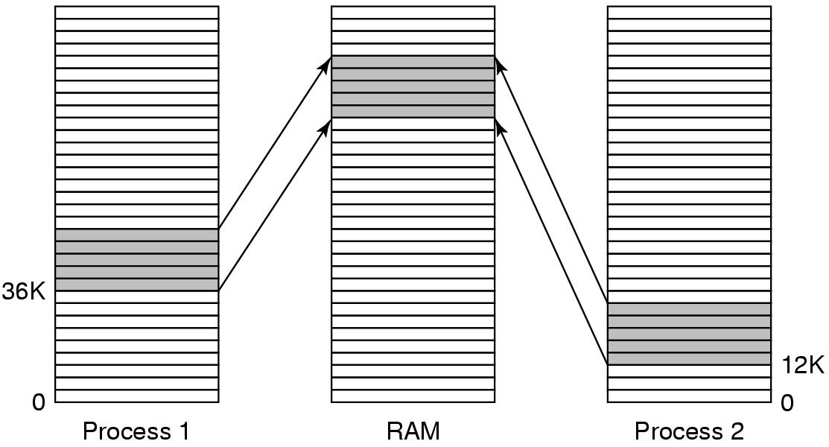
Shared Libraries
Figure 3-27. A shared library being used by two processes.
Tanenbaum, Modern Operating Systems 3 e, (c) 2008 Prentice-Hall, Inc. All rights reserved. 0-13-6006639

Slide 48
Page Fault Handling (1)
The hardware traps to the kernel, saving the program counter on the stack.
An assembly code routine is started to save the general registers and other volatile information.
The operating system discovers that a page fault has occurred, and tries to discover which virtual page is needed.
Once the virtual address that caused the fault is known, the system checks to see if this address is valid and the protection consistent with the access
Tanenbaum, Modern Operating Systems 3 e, (c) 2008 Prentice-Hall, Inc. All rights reserved. 0-13-6006639

Slide 49
Page Fault Handling (2)
If the page frame selected is dirty, the page is scheduled for transfer to the disk, and a context switch takes place.
When page frame is clean, operating system looks up the disk address where the needed page is, schedules a disk operation to bring it in.
When disk interrupt indicates page has arrived, page tables updated to reflect position, frame marked as being in normal state.
Tanenbaum, Modern Operating Systems 3 e, (c) 2008 Prentice-Hall, Inc. All rights reserved. 0-13-6006639

Slide 50
Page Fault Handling (3)
Faulting instruction backed up to state it had when it began and program counter reset to point to that instruction.
Faulting process scheduled, operating system returns to the (assembly language) routine that called it.
This routine reloads registers and other state information and returns to user space to continue execution, as if no fault had occurred.
Tanenbaum, Modern Operating Systems 3 e, (c) 2008 Prentice-Hall, Inc. All rights reserved. 0-13-6006639

Slide 51
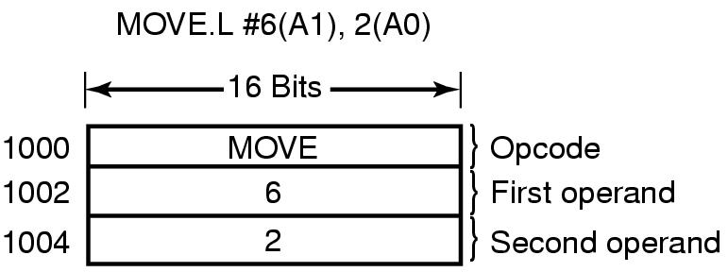
Instruction Backup
Figure 3-28. An instruction causing a page fault.
Tanenbaum, Modern Operating Systems 3 e, (c) 2008 Prentice-Hall, Inc. All rights reserved. 0-13-6006639

Slide 52
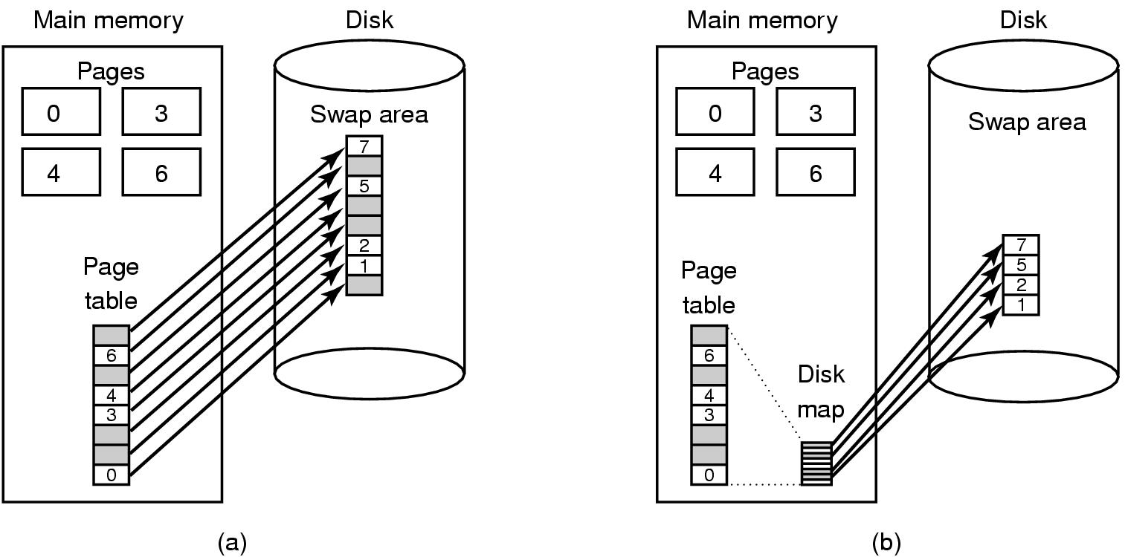
Backing Store (1)
Figure 3-29. (a) Paging to a static swap area.
Tanenbaum, Modern Operating Systems 3 e, (c) 2008 Prentice-Hall, Inc. All rights reserved. 0-13-6006639

Slide 53
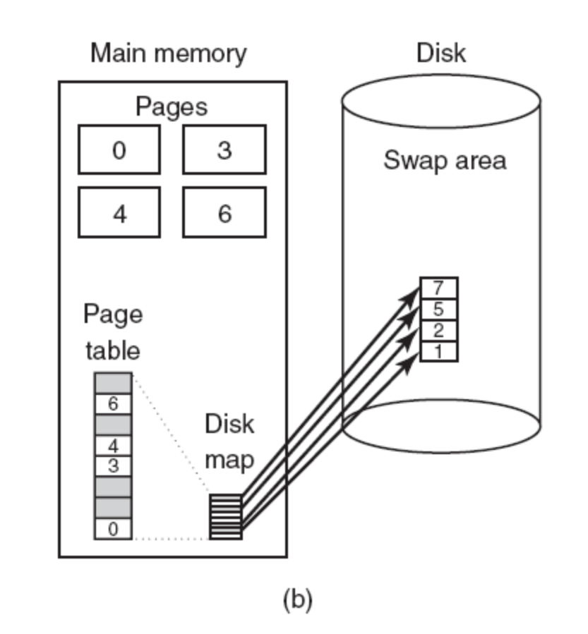
Backing Store (2)
Figure 3-29. (b) Backing up pages dynamically.
Tanenbaum, Modern Operating Systems 3 e, (c) 2008 Prentice-Hall, Inc. All rights reserved. 0-13-6006639

Slide 54
Separation of Policy and Mechanism (1)
Memory management system is divided into
three parts:
A low-level MMU handler.
A page fault handler that is part of the kernel.
An external pager running in user space.
Tanenbaum, Modern Operating Systems 3 e, (c) 2008 Prentice-Hall, Inc. All rights reserved. 0-13-6006639

Slide 55
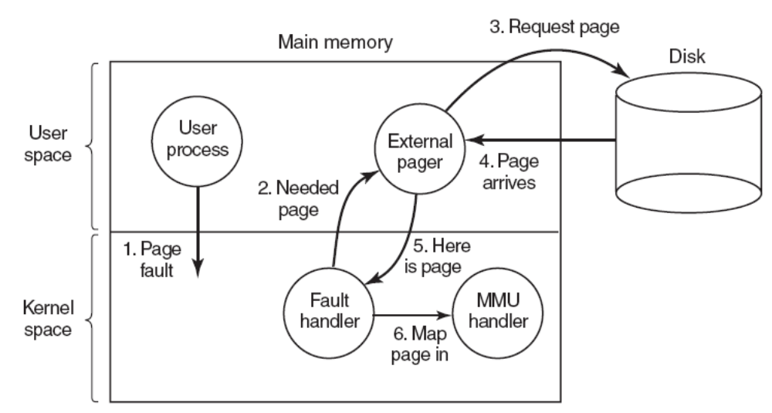
Separation of Policy and Mechanism (2)
Figure 3-30. Page fault handling with an external pager.
Tanenbaum, Modern Operating Systems 3 e, (c) 2008 Prentice-Hall, Inc. All rights reserved. 0-13-6006639

Slide 56
Segmentation (1)
A compiler has many tables that are built up as compilation proceeds, possibly including:
The source text being saved for the printed listing (on batch systems).
The symbol table – the names and attributes of variables.
The table containing integer, floating-point constants used.
The parse tree, the syntactic analysis of the program.
The stack used for procedure calls within the compiler.
Tanenbaum, Modern Operating Systems 3 e, (c) 2008 Prentice-Hall, Inc. All rights reserved. 0-13-6006639

Slide 57

Segmentation (2)
Figure 3-31. In a one-dimensional address space with growing tables, one table may bump into another.
Tanenbaum, Modern Operating Systems 3 e, (c) 2008 Prentice-Hall, Inc. All rights reserved. 0-13-6006639

Slide 58
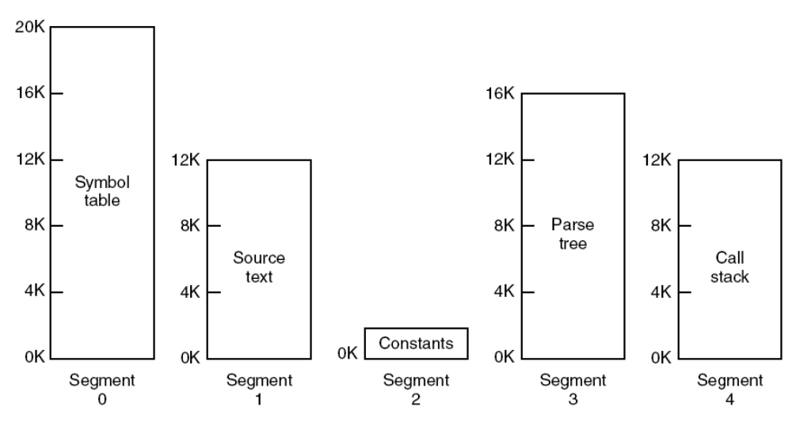
Segmentation (3)
Figure 3-32. A segmented memory allows each table to grow or shrink independently of the other tables.
Tanenbaum, Modern Operating Systems 3 e, (c) 2008 Prentice-Hall, Inc. All rights reserved. 0-13-6006639

Slide 59

Implementation of Pure Segmentation
Figure 3-33. Comparison of paging and segmentation.
Tanenbaum, Modern Operating Systems 3 e, (c) 2008 Prentice-Hall, Inc. All rights reserved. 0-13-6006639

Slide 60
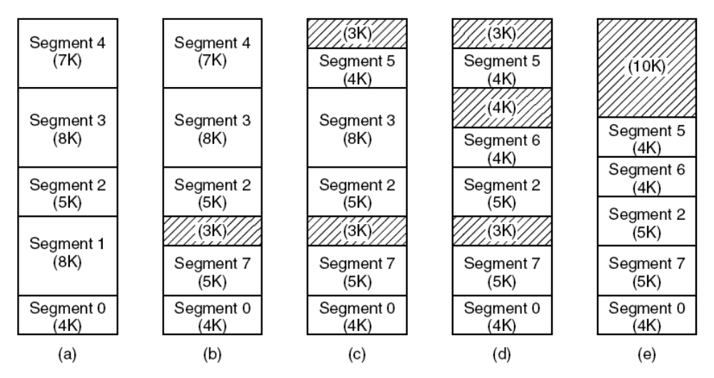
Segmentation with Paging: MULTICS (1)
Figure 3-34. (a)-(d) Development of checkerboarding. (e) Removal of the checkerboarding by compaction.
Tanenbaum, Modern Operating Systems 3 e, (c) 2008 Prentice-Hall, Inc. All rights reserved. 0-13-6006639

Slide 61
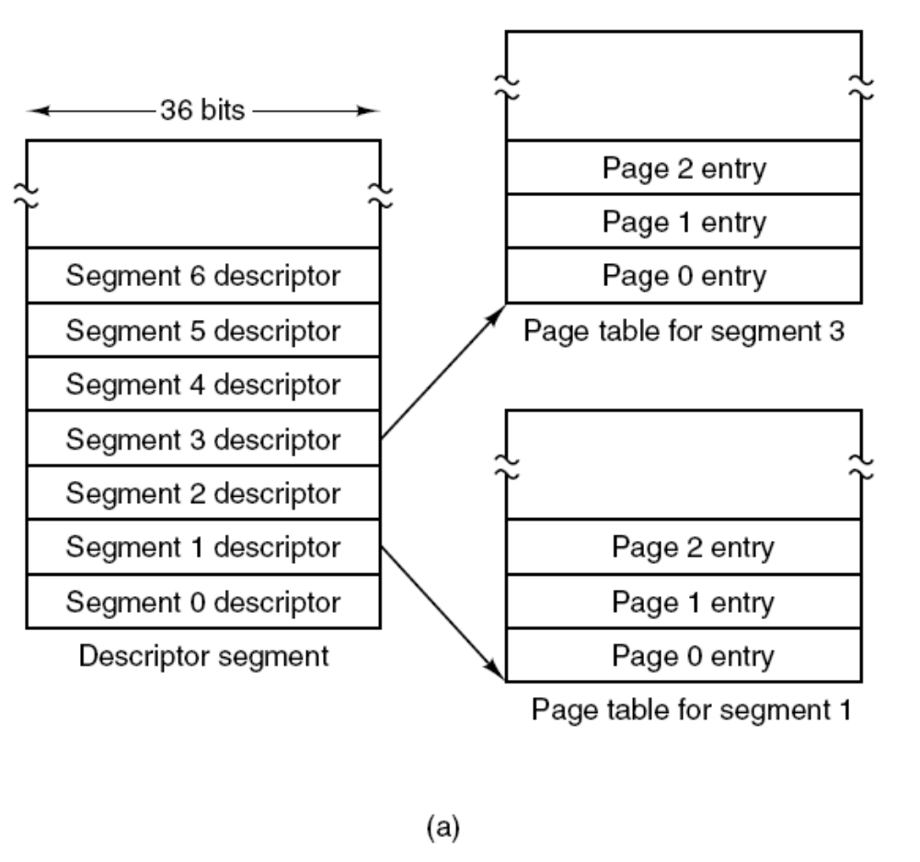
Segmentation with Paging: MULTICS (2)
Figure 3-35. The MULTICS virtual memory. (a) The descriptor segment points to the page tables.
Tanenbaum, Modern Operating Systems 3 e, (c) 2008 Prentice-Hall, Inc. All rights reserved. 0-13-6006639

Slide 62
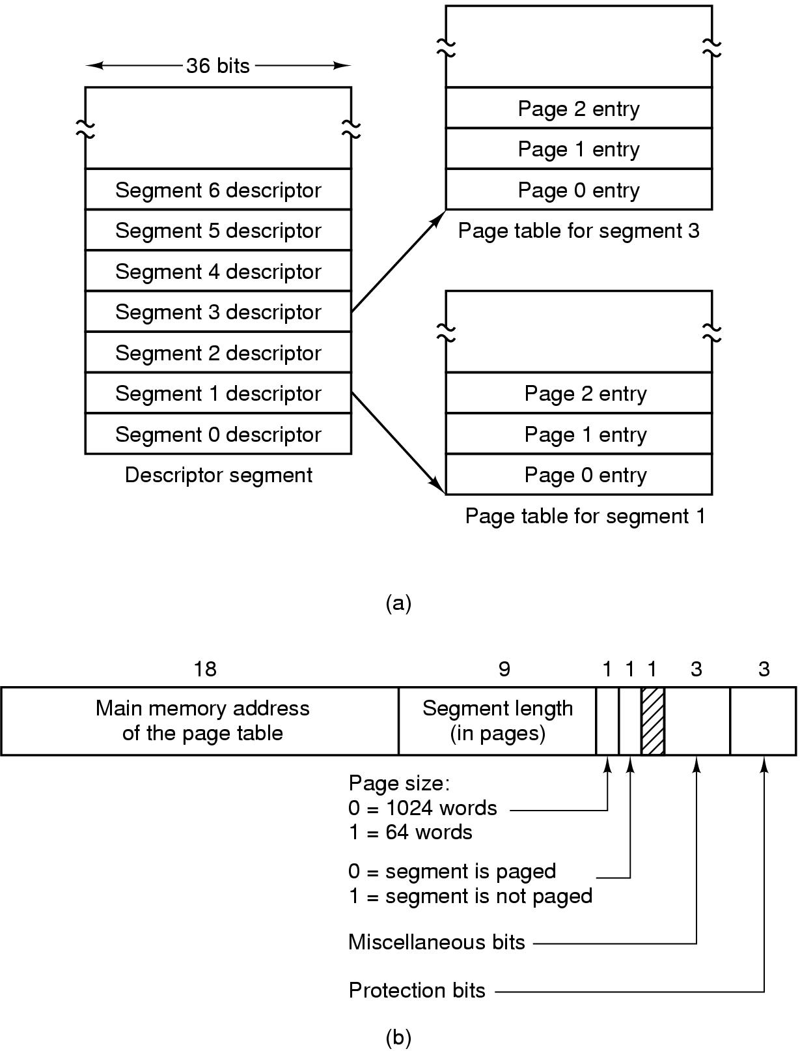
Segmentation with Paging: MULTICS (5)
Figure 3-35. The MULTICS virtual memory. (b) A segment descriptor. The numbers are the field lengths.
Tanenbaum, Modern Operating Systems 3 e, (c) 2008 Prentice-Hall, Inc. All rights reserved. 0-13-6006639

Slide 63
Segmentation with Paging: MULTICS (6)
When a memory reference occurs, the following algorithm is carried out:
The segment number used to find segment descriptor.
Check is made to see if the segment’s page table is in memory.
  If not, segment fault occurs.
  If there is a protection violation, a fault (trap) occurs.
Tanenbaum, Modern Operating Systems 3 e, (c) 2008 Prentice-Hall, Inc. All rights reserved. 0-13-6006639

Slide 64
Segmentation with Paging: MULTICS (7)
Page table entry for the requested virtual page examined.
  If the page itself is not in memory, a page fault is triggered.
  If it is in memory, the main memory address of the start of the page is extracted from the page table entry
The offset is added to the page origin to give the main memory address where the word is located.
The read or store finally takes place.
Tanenbaum, Modern Operating Systems 3 e, (c) 2008 Prentice-Hall, Inc. All rights reserved. 0-13-6006639

Slide 65
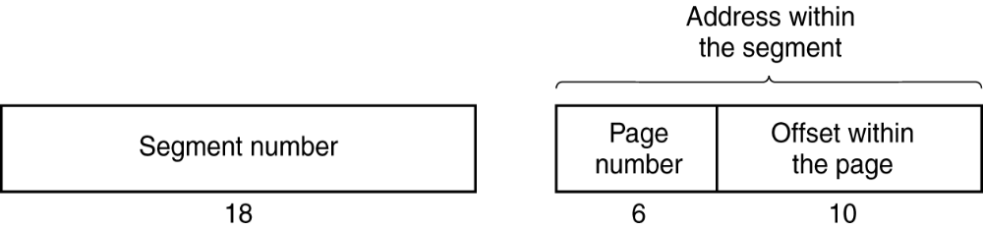
Segmentation with Paging: MULTICS (8)
Figure 3-36. A 34-bit MULTICS virtual address.
Tanenbaum, Modern Operating Systems 3 e, (c) 2008 Prentice-Hall, Inc. All rights reserved. 0-13-6006639

Slide 66
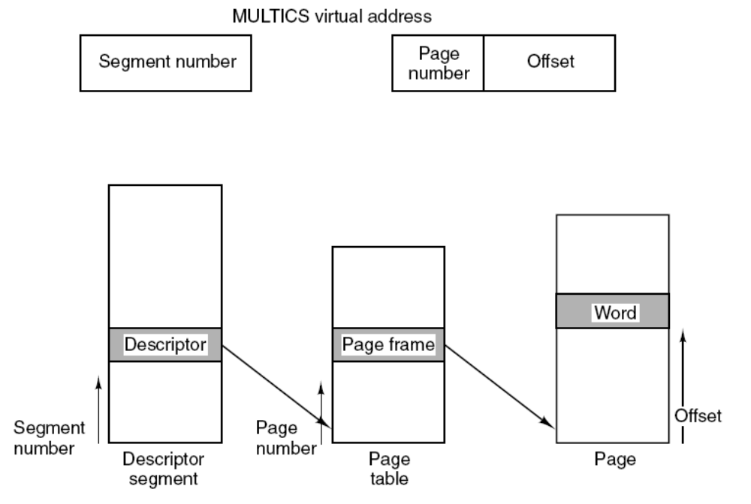
Segmentation with Paging: MULTICS (9)
Figure 3-37. Conversion of a two-part MULTICS address into a main memory address.
Tanenbaum, Modern Operating Systems 3 e, (c) 2008 Prentice-Hall, Inc. All rights reserved. 0-13-6006639

Slide 67
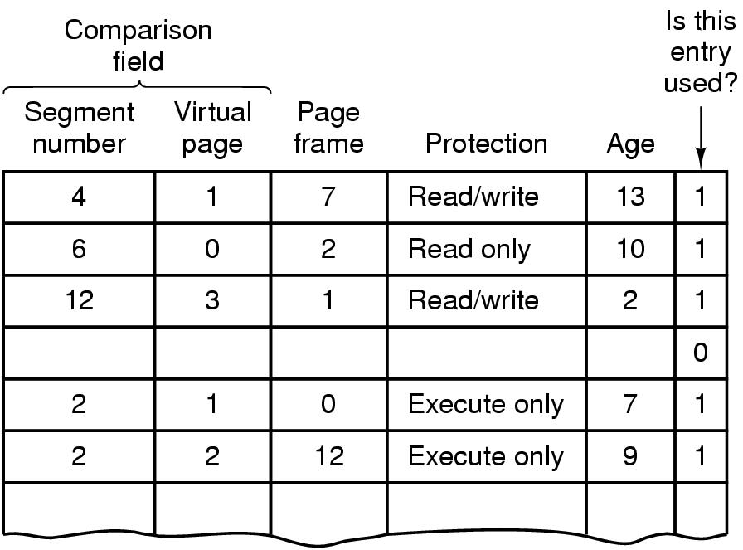
Segmentation with Paging: MULTICS (10)
Figure 3-38. A simplified version of the MULTICS TLB. The existence of two page sizes makes the actual TLB more complicated.
Tanenbaum, Modern Operating Systems 3 e, (c) 2008 Prentice-Hall, Inc. All rights reserved. 0-13-6006639

Slide 68
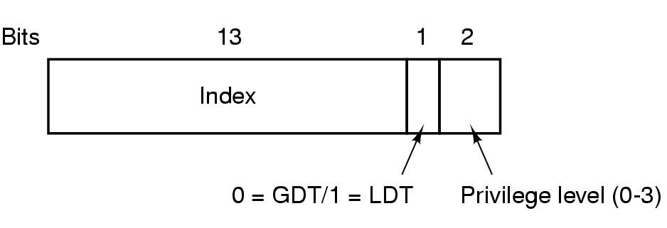
Segmentation with Paging: The Pentium (1)
Figure 3-39. A Pentium selector.
Tanenbaum, Modern Operating Systems 3 e, (c) 2008 Prentice-Hall, Inc. All rights reserved. 0-13-6006639

Slide 69
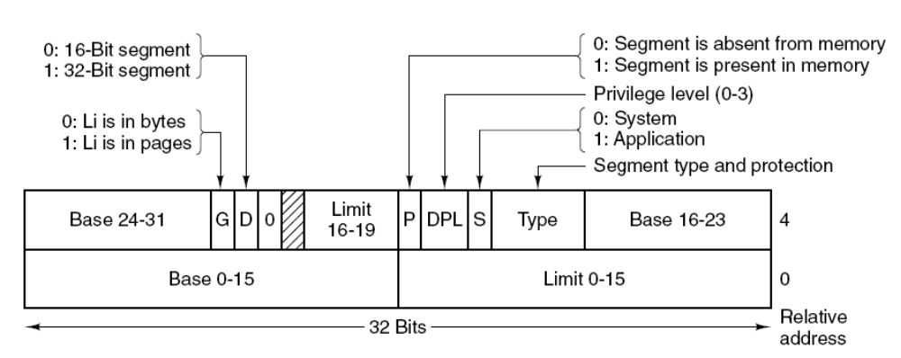
Segmentation with Paging: The Pentium (2)
Figure 3-40. Pentium code segment descriptor.
Data segments differ slightly.
Tanenbaum, Modern Operating Systems 3 e, (c) 2008 Prentice-Hall, Inc. All rights reserved. 0-13-6006639

Slide 70
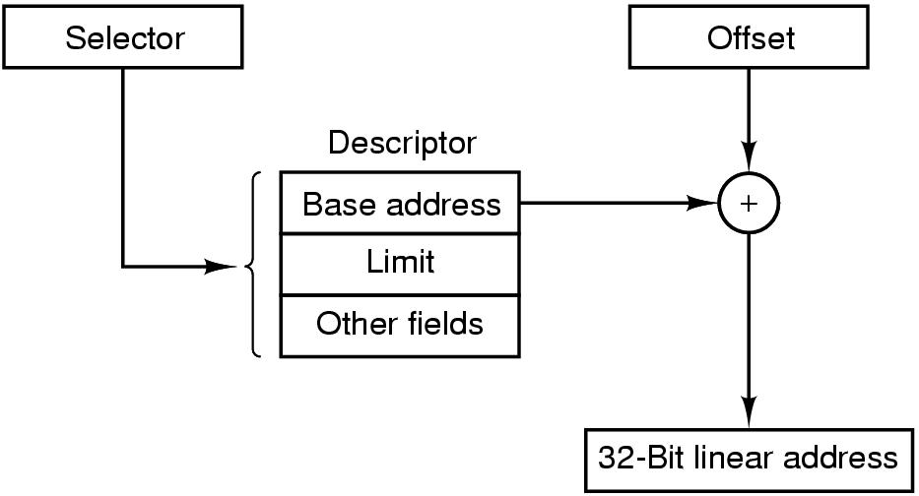
Segmentation with Paging: The Pentium (3)
Figure 3-41. Conversion of a (selector, offset)
pair to a linear address.
Tanenbaum, Modern Operating Systems 3 e, (c) 2008 Prentice-Hall, Inc. All rights reserved. 0-13-6006639

Slide 71
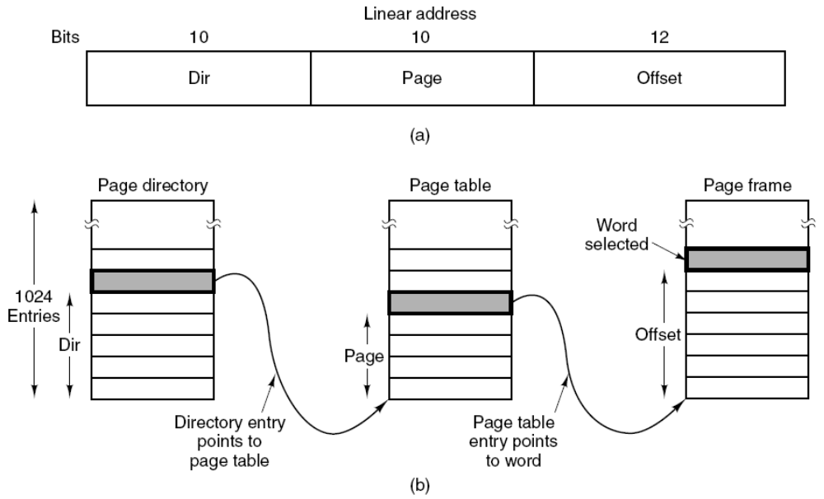
Segmentation with Paging: The Pentium (4)
Figure 3-42. Mapping of a linear address onto a physical address.
Tanenbaum, Modern Operating Systems 3 e, (c) 2008 Prentice-Hall, Inc. All rights reserved. 0-13-6006639

Slide 72
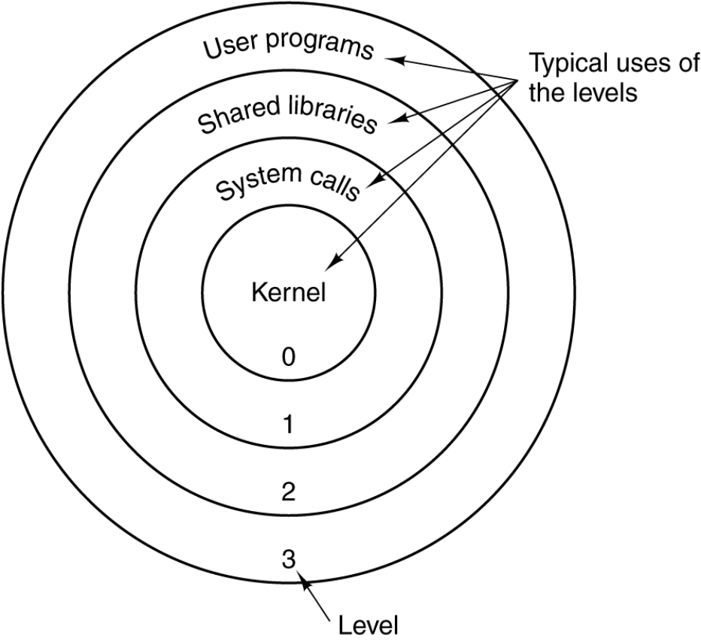
Segmentation with Paging: The Pentium (5)
Figure 3-43. Protection on the Pentium.
Tanenbaum, Modern Operating Systems 3 e, (c) 2008 Prentice-Hall, Inc. All rights reserved. 0-13-6006639

